Slide 1
MONOPOLISTIC COMPETITION
Dr. Napinder Kaur
Assistant Professor

Slide 2
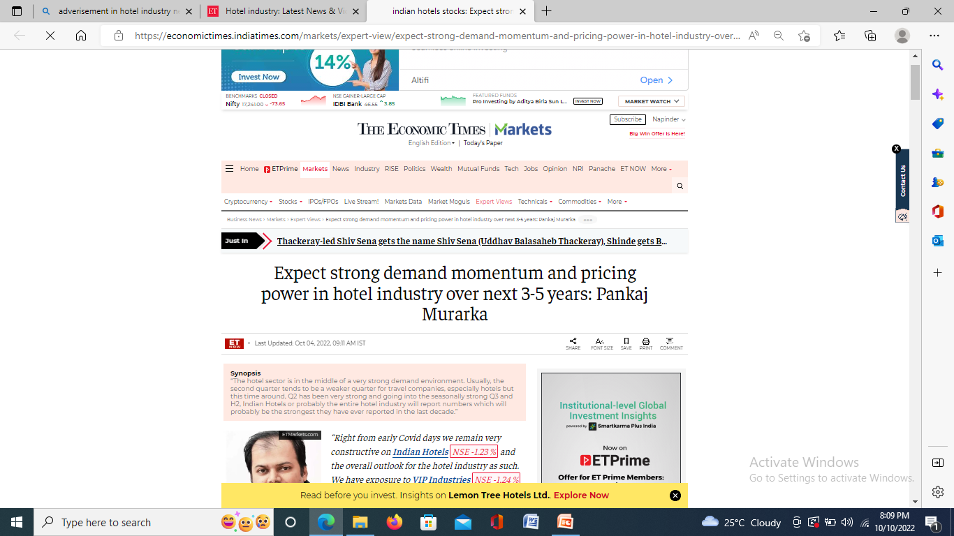
WHAT’S IN THE NEWS?

Slide 3
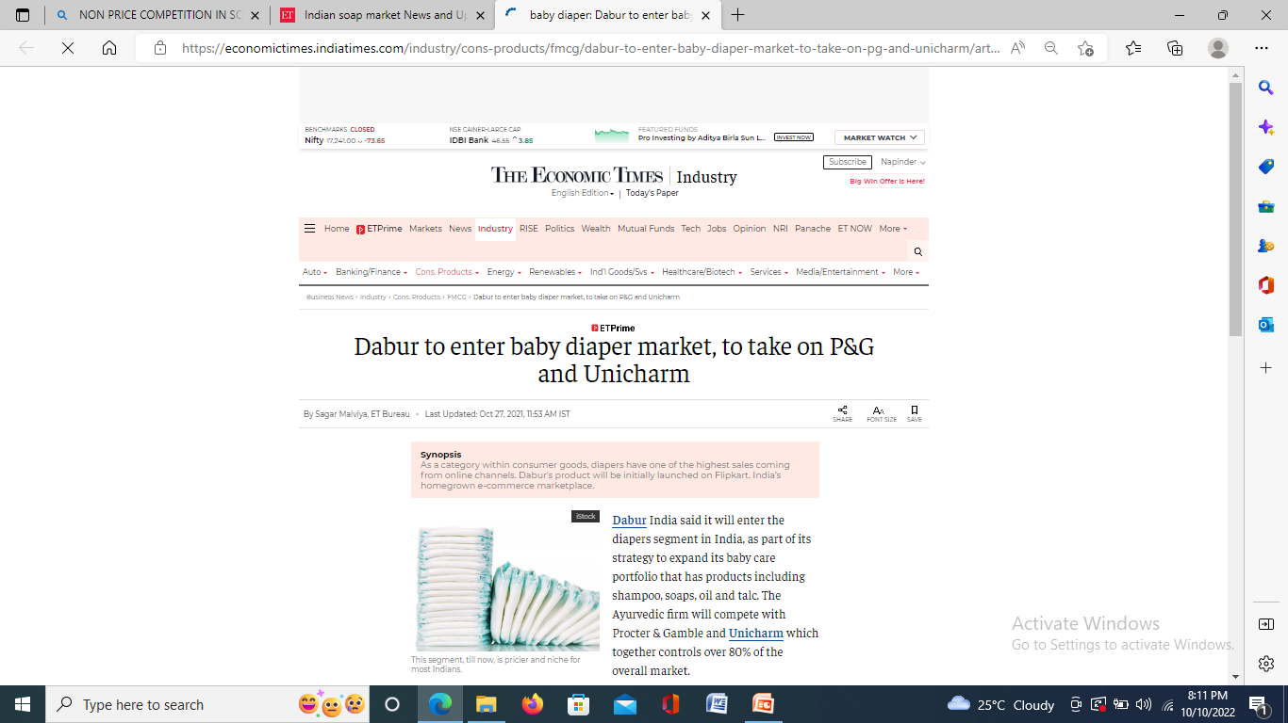

Slide 4
LEARNING OUTCOMES
After the lecture, you will be able to
Understand the nature of monopolistic competition.
Analyse the pricing and output decisions of a monopolistic competitive firm in the short run and long run.

Slide 5
MONOPOLISTIC COMPETITION
Monopolistic competition is a market situation in which a relatively large number of producers offer similar but not identical products.

Slide 6
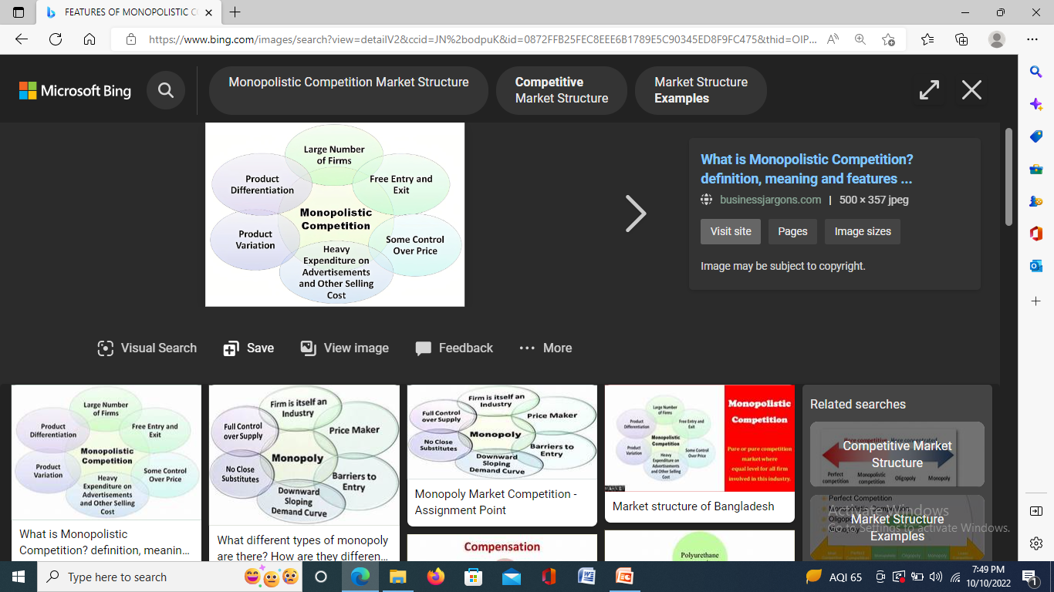
FEATURES

Slide 7
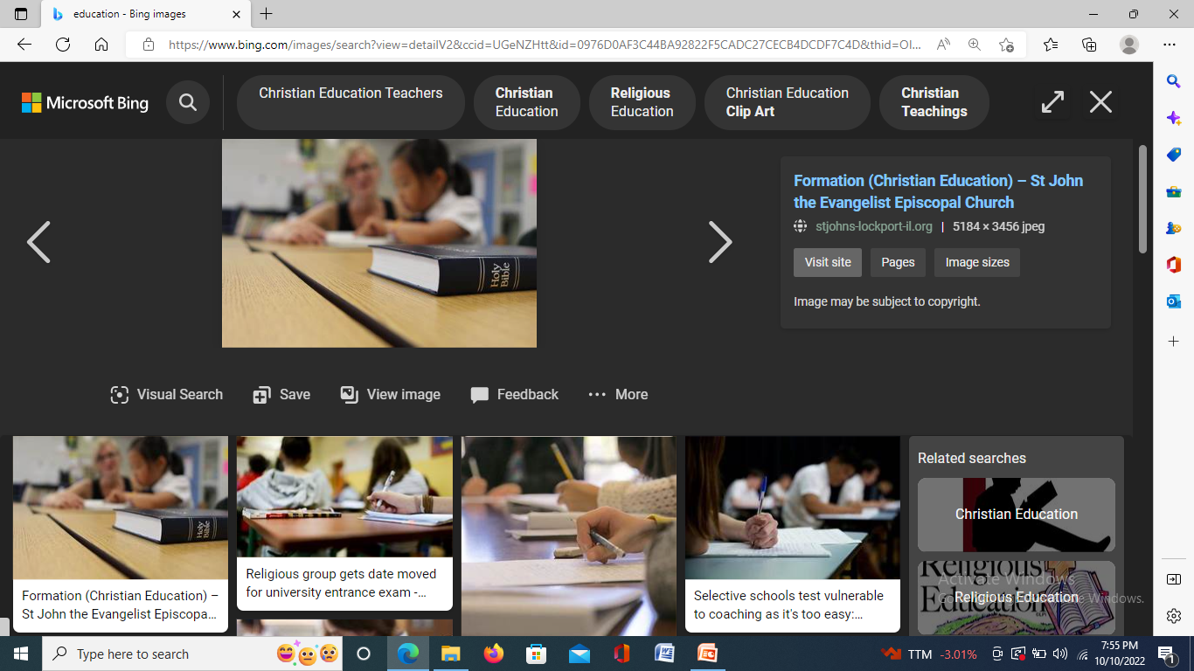
REALITY BITES
Are colleges and universities examples of monopolistically competitive industries?

Slide 8
PRICE AND OUTPUT DECISIONS IN SHORT RUN
Supernormal profits
Normal profits
Loss

Slide 9
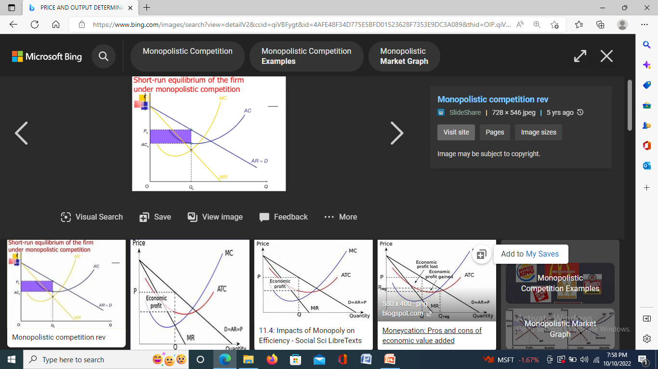
SUPERNORMAL PROFITS

Slide 10
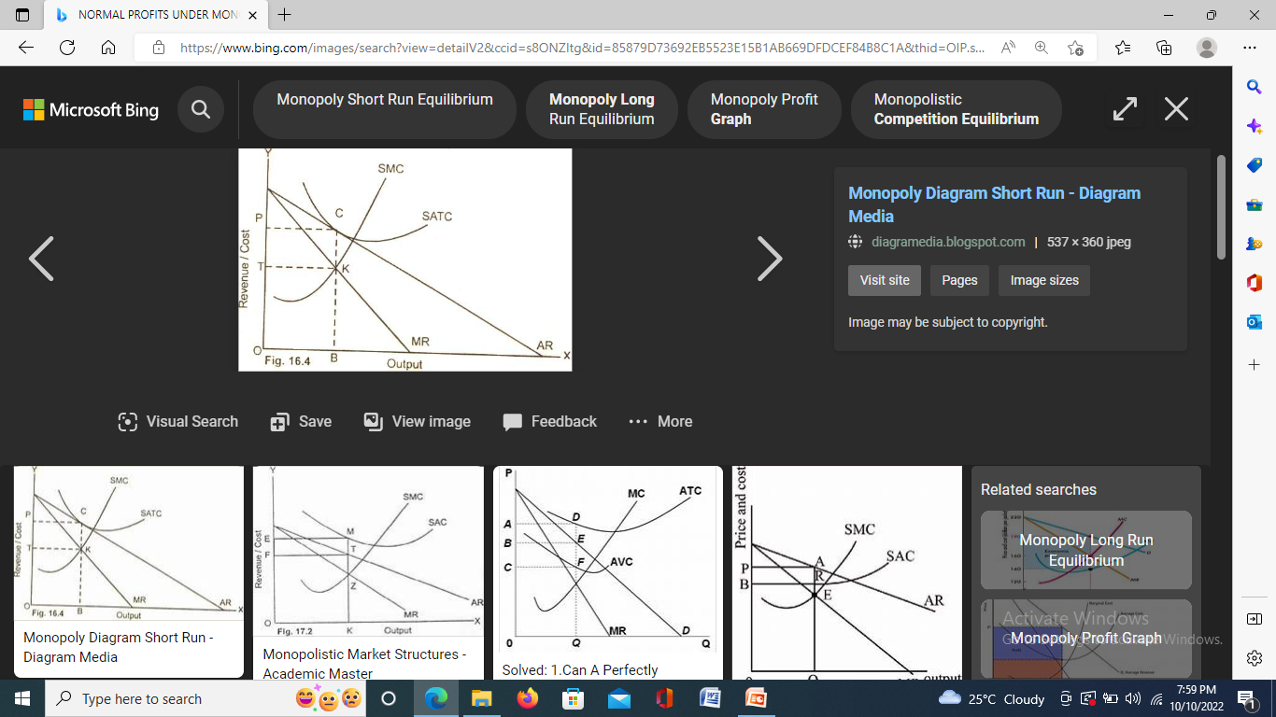
NORMAL PROFITS

Slide 11
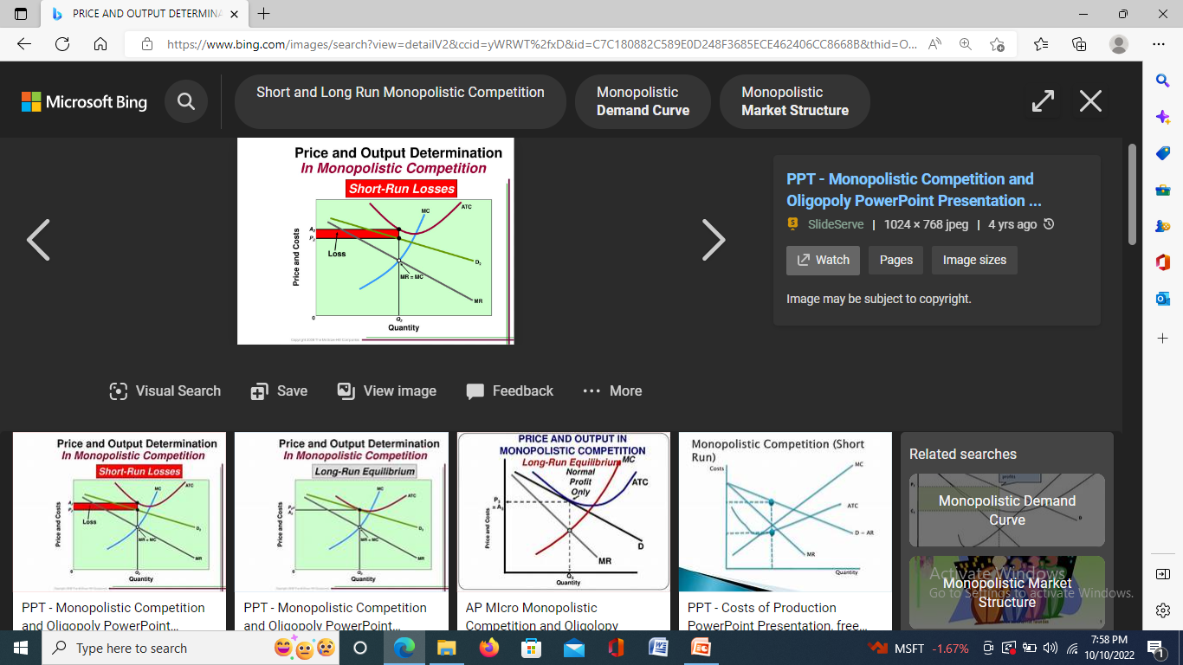
LOSS

Slide 12
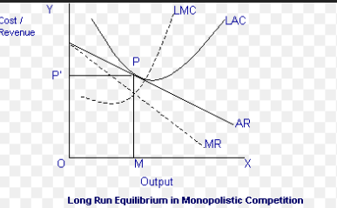
LONG RUN PRICE AND OUTPUT DECISIONS
Normal profits

Slide 13
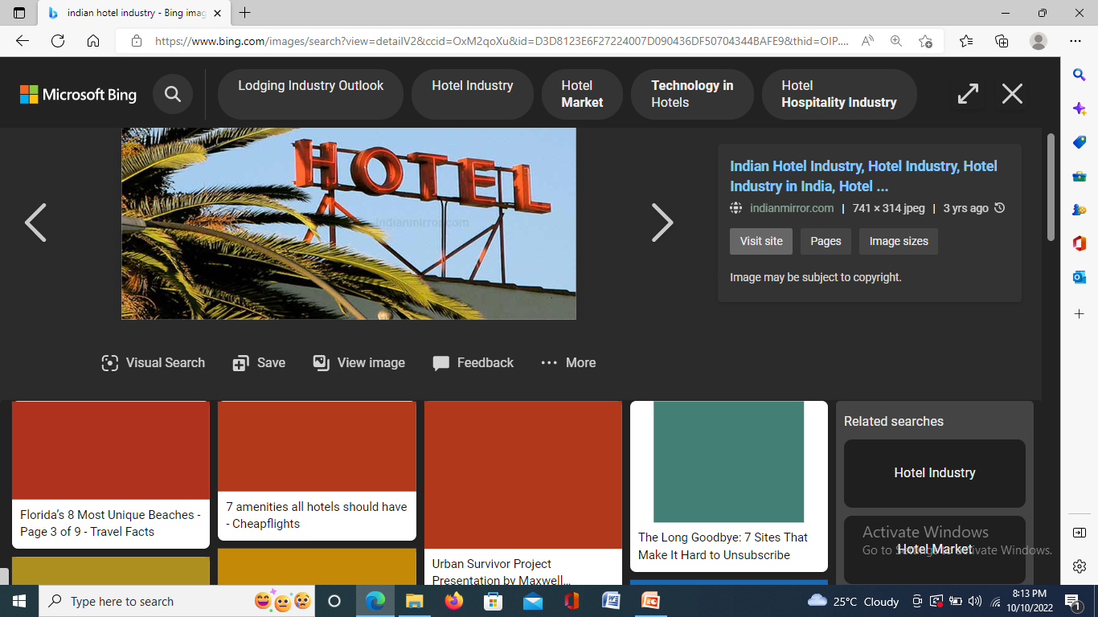
CASE ANALYSIS
Booming Business: Indian Hotel Industry

Slide 14
MONOPOLISTIC COMPETITION AND ADVERTISEMENT
It is more profitable for a monopolistically competitive firm to attract customers through advertisement rather than lowering the price.

Slide 15
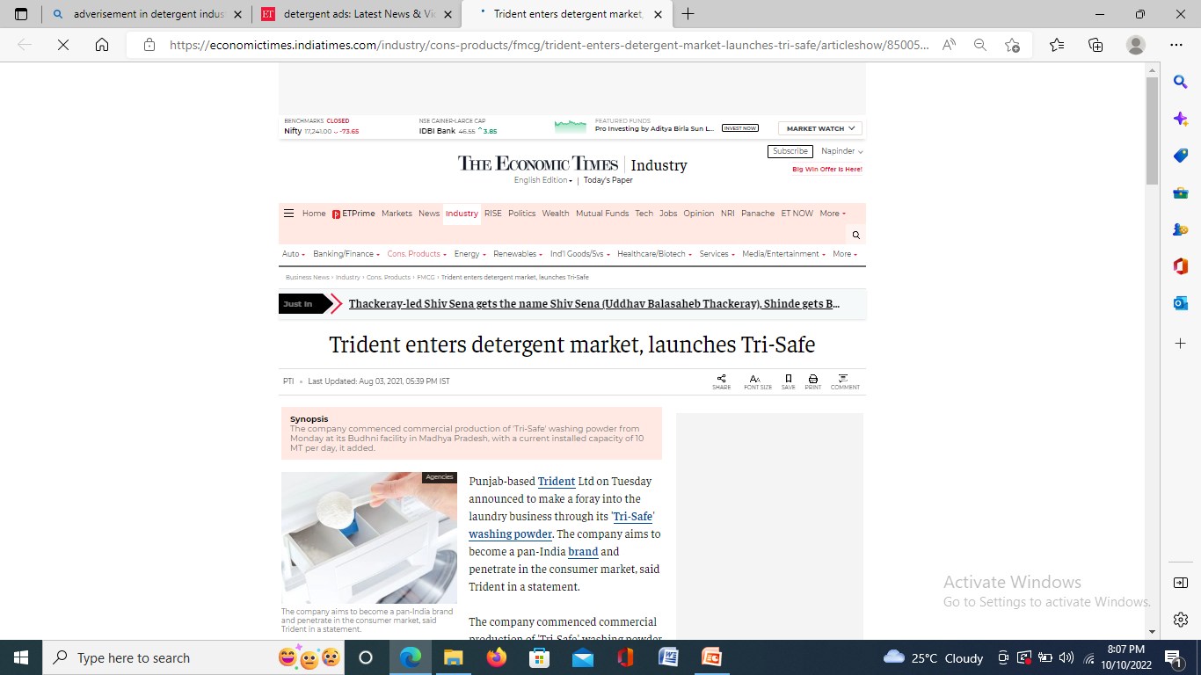
OPTIMUM LEVEL OF ADVERTISING
MR(A) = MC(A)

